Slide 1
ODSC India 2019
Midcurve by Neural Networks
Yogesh Kulkarni

Slide 2
MidcurveNN : Encoder-Decoder Neural Network for Computing Midcurve of a Thin Polygon

Slide 3
INTRODUCTION

Slide 4
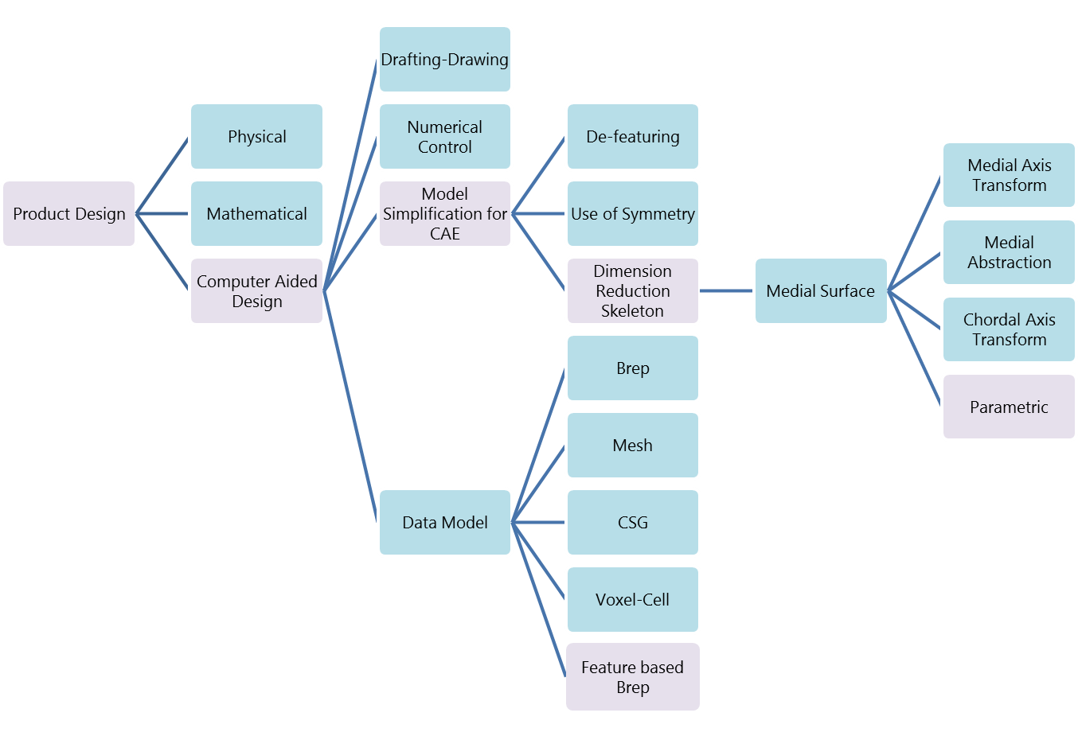
The Context

Slide 5
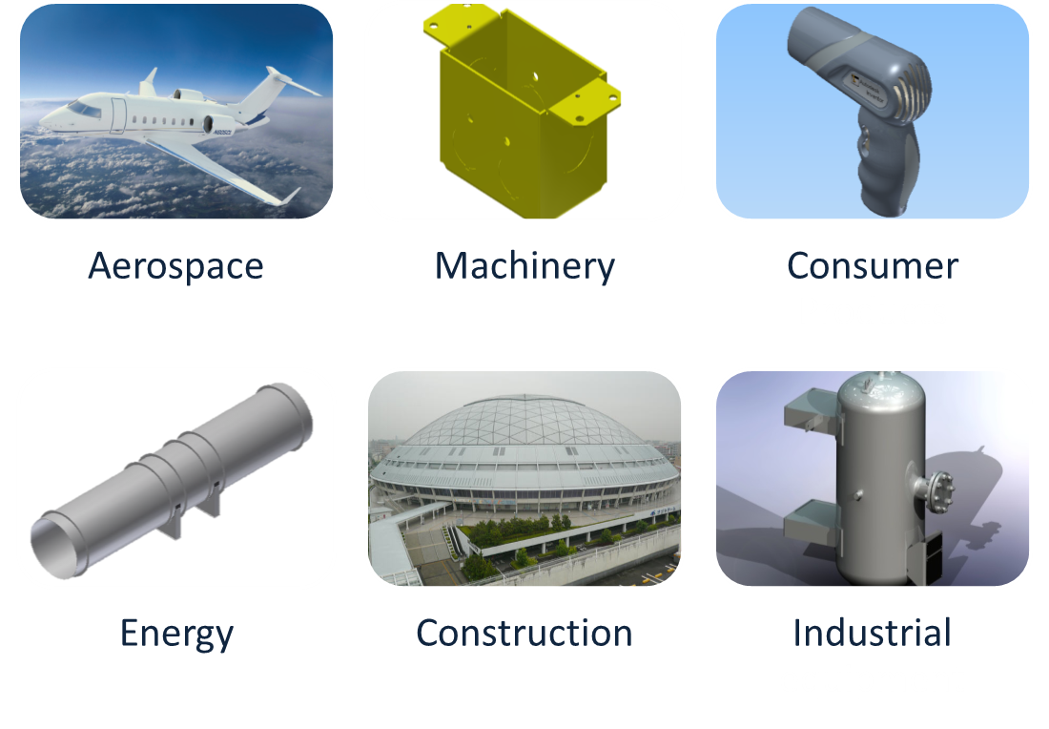
Main Applications

Slide 6
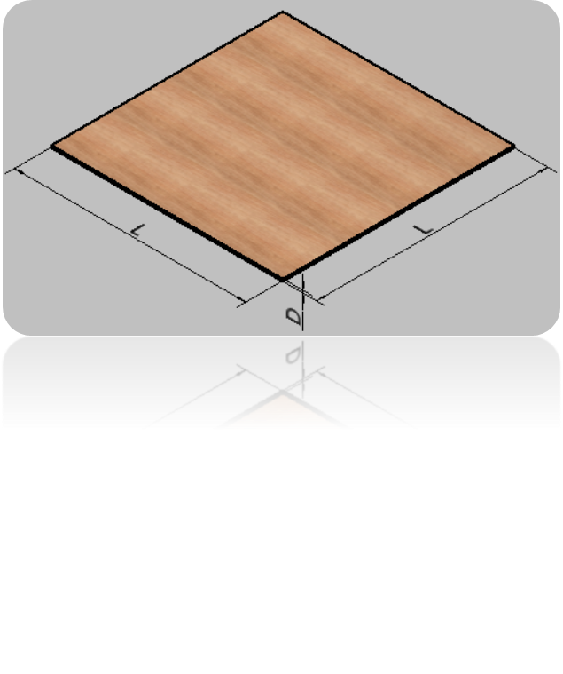
What is Thin
It is defined as a part or body with large effective span to thickness ratio (L/D)
  Well-common FEA practice
  L/D ≥ 100
  Generally, pressure vessel
  R ≥ 5xT
  R – radius, T - thickness
Notes:
Well-common FEA practice to consider solid body with l/d > 100 as a thin-wall model.
Real ratio = power (36 * PI * (bVol * bVol) / (area * area * area), 1/6)
Generally, pressure vessel is considered to be "thin-walled" if its radius r is larger than 5 times its wall thickness t (r >5xt)

Slide 7

Shell vs. Solid mesh
 | Solid mesh | Shell+Solid mesh | Difference (%)
Element number | 344,330 | 143,063 | -58%
Node Number | 694,516 | 75,941 | -89%
Total Degrees of freedom | 2,083,548 | 455,646 | -78%
Maximum Von. Mises Stress | 418.4 MPa | 430 MPa | +3%
Meshing + Solving time | Out of memory | 22 mins | N/A (4G RAM)
Meshing + Solving time | 30 mins | 17 mins | -43% (12G RAM)

Slide 8
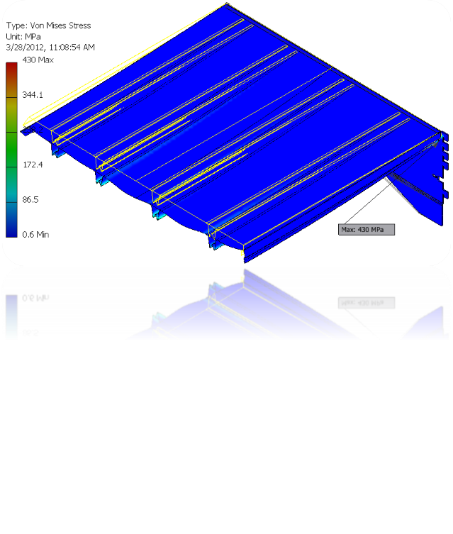
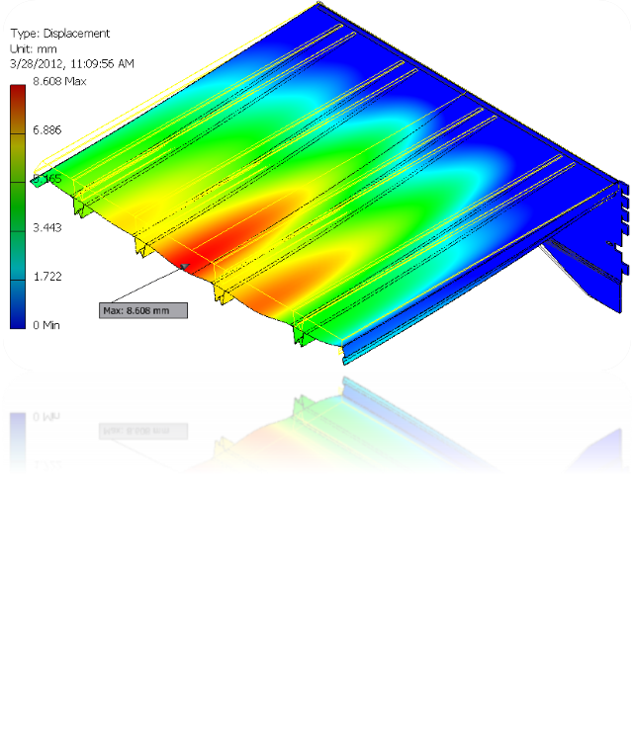
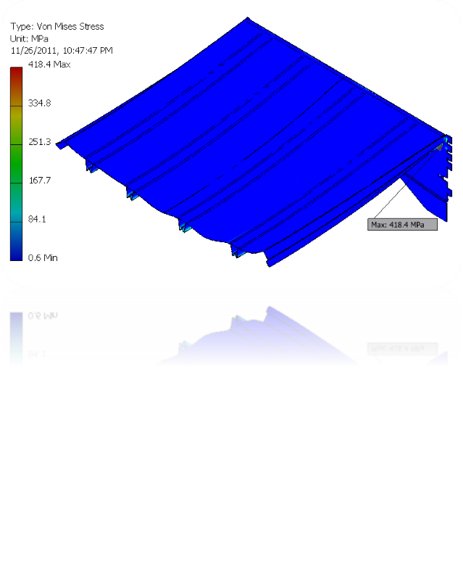
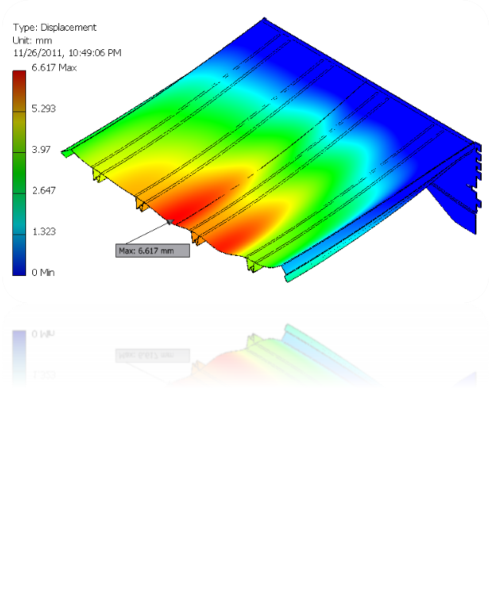
Shell vs. Solid mesh
Shell mesh
Solid mesh

Slide 9
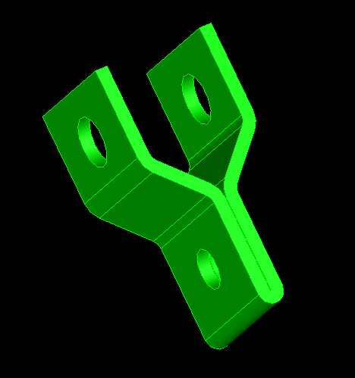
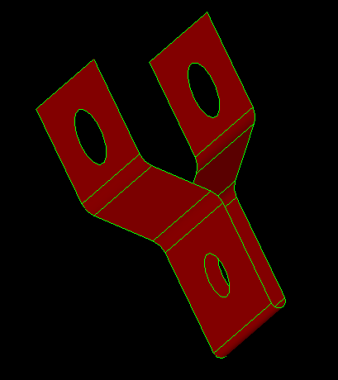
Midsurface is?
Surface approximation for the thin-walled model
Used to create shell element model for shell analysis
Not expected to work for thick models
Input: Solid
Output: Midsurface

Slide 10
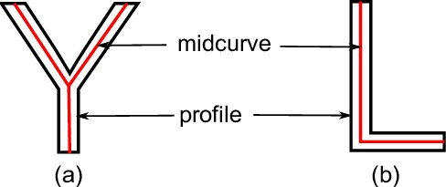
What is a Midcurve?
Midsurface : From 3D thin Solid to 2D Surface
Midcurve : From 2D Profile to 1D Curve

Slide 11
STATE OF THE ART

Slide 12
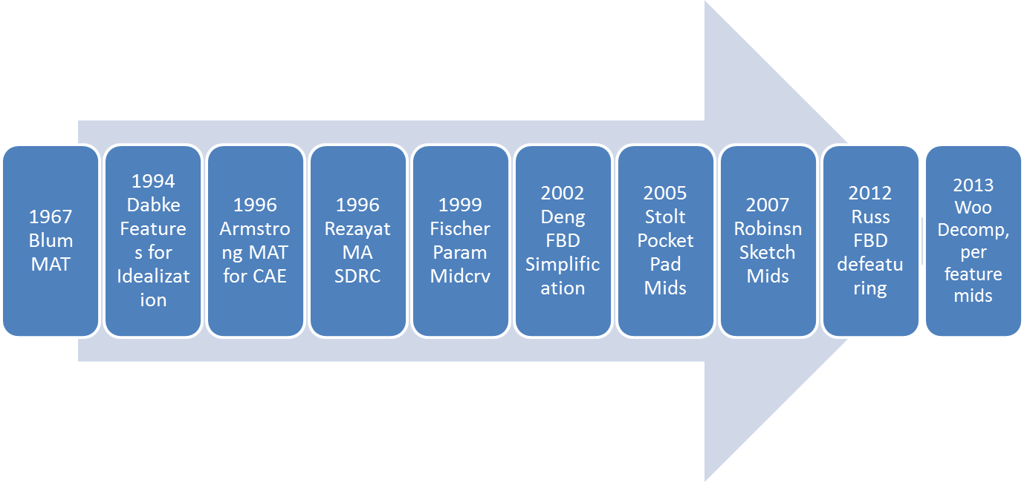
When-What

Slide 13
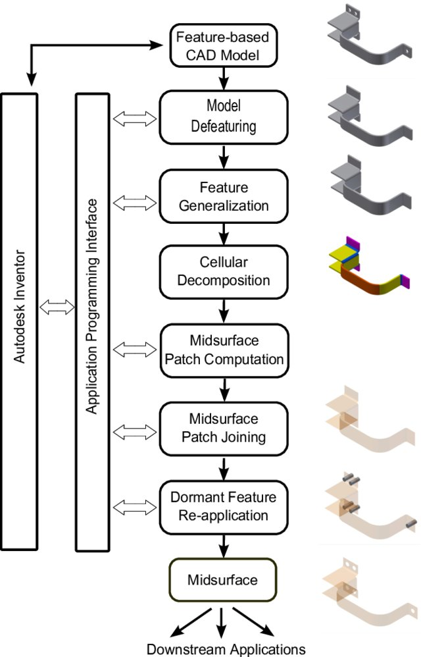
2017 My Doctoral Work

Slide 14
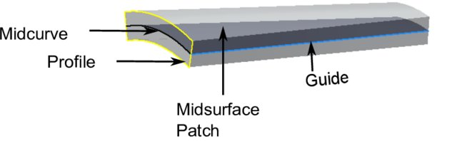
Midcurve Computation
Midsurface of a Patch is Midcurve of its profile extruded.
So, it boils down to computing 1D midcurve of a 2D profile

Slide 15
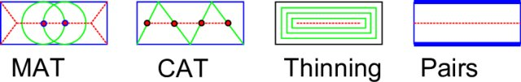
Midcurve Approaches
Midsurface of a Patch is Midcurve of its profile extruded.
So, it boils down to computing 1D midcurve of a 2D profile

Slide 16
Literature Survey - Conclusions
“There is a deﬁnite need for a dimensional reduction capability that is more powerful and easier to use than those currently available in the market. Such a capability should deliver an automated scheme for handling cases that have traditionally caused problems for algorithms in this ﬁeld” - Stanley2010
“Much of research is yet to be done, use of symmetry, various features, various abstractions are not yet handled.”- Smit2011

Slide 17
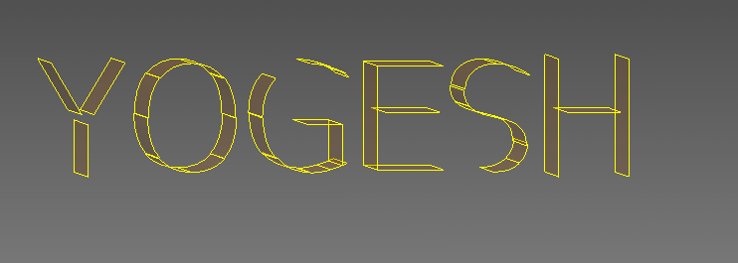
Problems Identified so far

Slide 18
2017: Proposed Approach
Given a 2D closed profile, get connected medial curves, no extra branches
Decompose 2D to find its sub regions, like features in 3D. Sub regions being simpler, it would be easy to get Midcurves, than skeleton of whole Profile.
Generate individual midcurves. Extend & Join

Slide 19
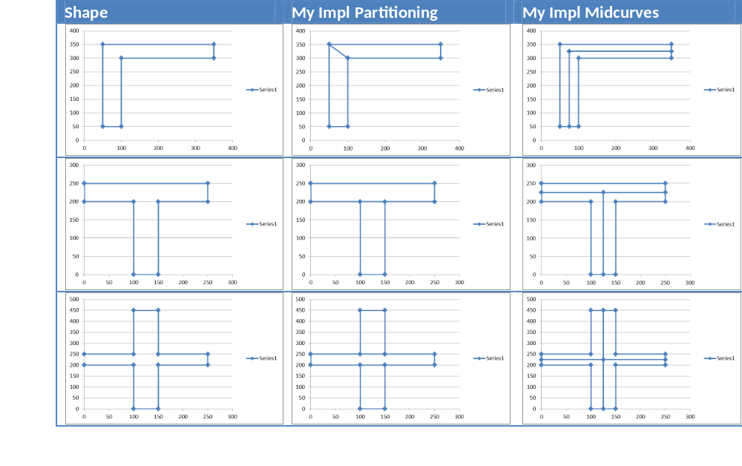
2017: Results 2D Midcurves

Slide 20
Limitations
Fully rule-based
Need to add/adjust rules if new type of shape comes
So, not scalable

Slide 21
Idea
Can Neural Networks “learn” the dimension reduction transformation?
Supply lots of training data of profiles and their corresponding midcurves and train.
Then given an unseen profile, can Neural Network compute a midcurve, mimicking the original profile shape?

Slide 22
MIDCURVE BY NEURAL NETWORK

Slide 23
Midcurve : The Problem
Goal: Given a 2D closed shape (closed polygon) find its midcurve (polyline, closed or open)
Input: set of points or set of connected lines, non-intersecting, simple, convex, closed polygon
Output: another set of points or set of connected lines, open/branched polygons possible

Slide 24
Midcurve == Dimension Reduction
Like PCA (Principal Component Analysis), wish to find Principal curve
That ‘represents’ the original profile shape

Slide 25
Midcurve == Translation
Left side (input): 2D Sketch Profile
Right Side (output): 1D Midcurve
Sequence 2 Sequence problem

Slide 26
Midcurve using Encoder Decoder
Its not Auto-Encoder as Input and Output are different
Its not fixed size i/o as Input and Output sizes are different

Slide 27
Variable Size Encoder Decoder
Typically, variable size gets converted to fixed size by Padding.
That’s OK for Machine Translations where padding values like “-1” can be added along with other words (vectors or indices)
But in Geometry, its not OK.
Because any value can represent a Valid Input, even though we don’t want it to be the input.

Slide 28
In the mean time
Till we get good variable size encoder decoder network…
Decided to convert this Sequence 2 Sequence problem as Image 2 Image problem.
Input: Black & White Image of 2D profile
Output: Black & White Image of 1D midcurve

Slide 29
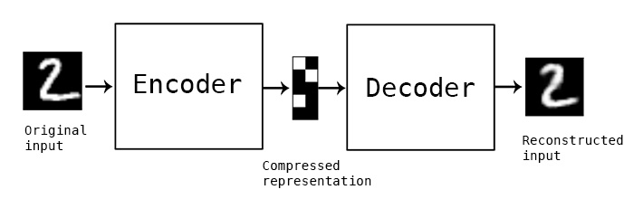
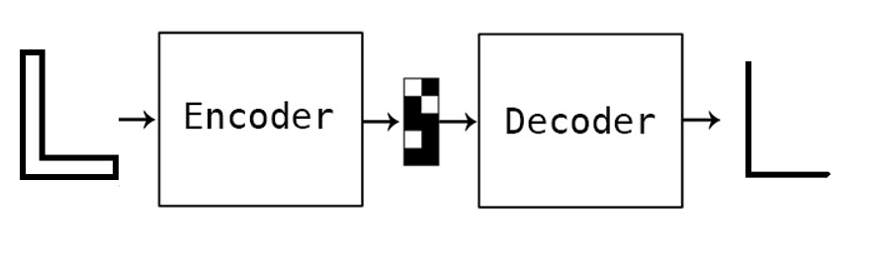
Updated Problem
Image Encoder Decoder
Can be used for

Slide 30
DATA PREPARATION

Slide 31
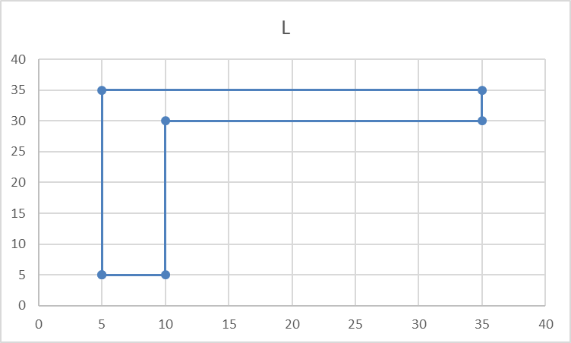
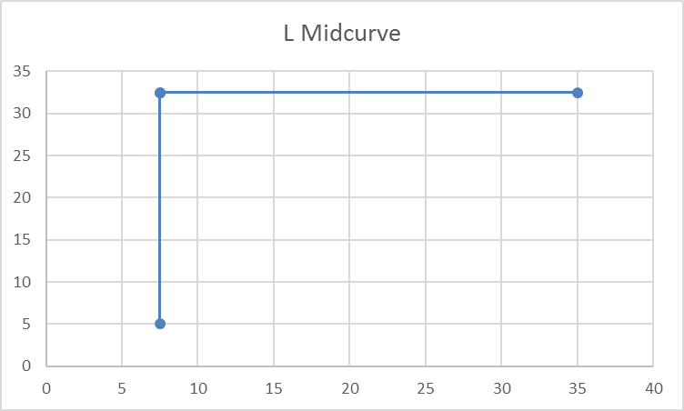
Data
Original input and output are in the form of polylines, meaning a list of points, each having x,y coordinates
Profile Data | Profile Picture | Midcurve Data | Midcurve Picture
5.0 5.0 10.0 5.0 10.0 30.0 35.0 30.0 35.0 35.0 5.0 35.0 |  | 7.5 5.0 7.5 32.5 35.0 32.5 7.5 32.5

Slide 32
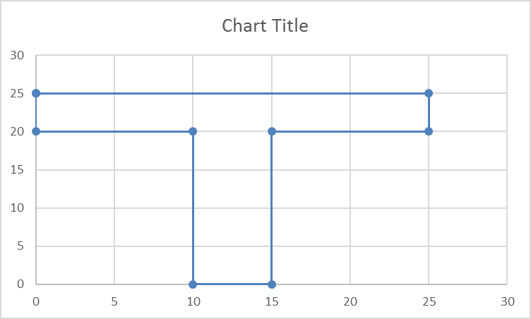
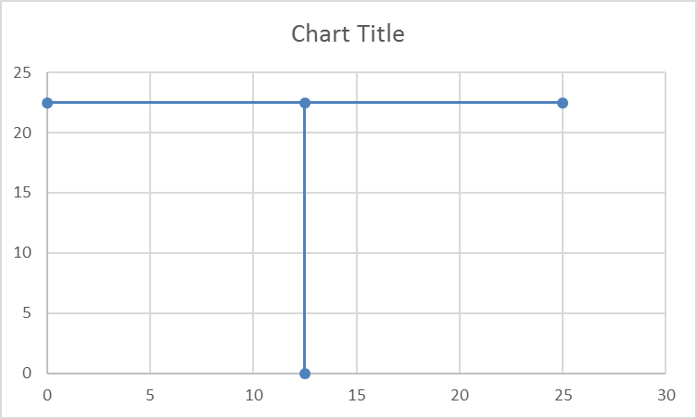
Data
For each shape, we have this pair of input and output. That’s it.
We need to start with these few samples only
Profile Data | Profile Picture | Midcurve Data | Midcurve Picture
0 25.0 25.0 25.0 25.0 20.0 15.0 20.0 15.0 0 10.0 0 10.0 20.0 0 20.0 |  | 12.5 0 12.5 22.5 25.0 22.5 0 22.5

Slide 33
Augmentation
Such few profile shapes, are just not enough for Neural Networks to train.
Need more with as much diversity as possible.
Will need to artificially augment data with transformations, like pan, rotate, mirror, etc.
All needs to be automatically, programmatically

Slide 34
Geometry to Image
Raw input data is in the Vector format
Converted it to fixed size (100x100) image by rasterization of drawSVG library.
This image was then transformed using various operations and saved.

Slide 35
Data Range
Input shapes: I, L, Plus, T
Operations:
  Translated
  Rotated
  Mirrored
  Mirrored Translated
  Mirrored Rotated
Total: 896 images (still less, but not bad)

Slide 36
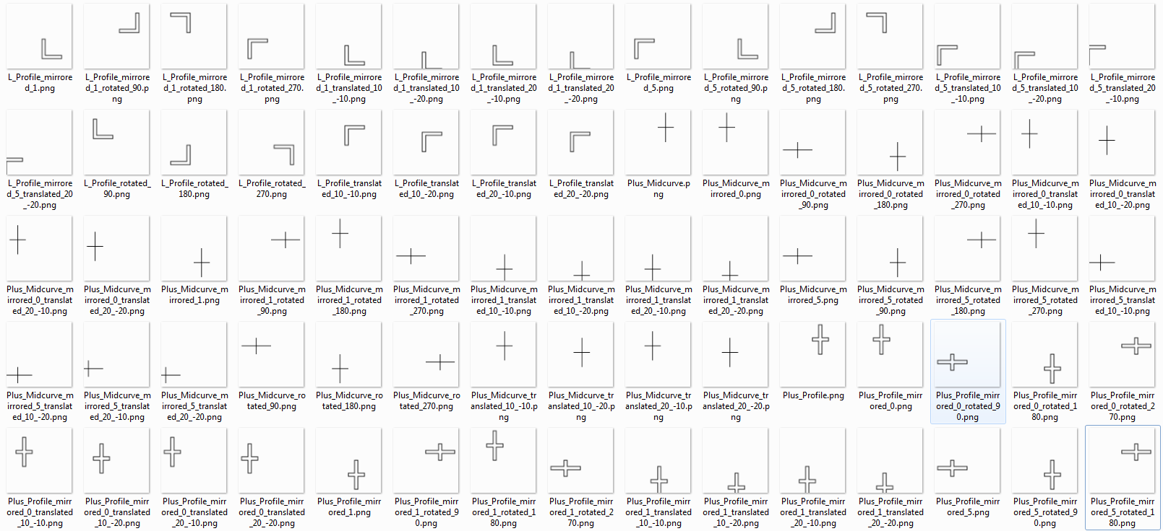
Training Data Samples

Slide 37
MIDCURVE NEURAL NETWORK

Slide 38
Various Architectures
Tried various architectures like:
  Simple Encoder Decoder (one layer each)
  Dense Encoder Decoder
  Convolutional Encoder Decoder
  Pix2Pix
With the given (small) data, Simple Encoder Decoder worked best amongst all the options.

Slide 39
Simple Encoder Decoder
input_img = Input(shape=(input_dim,))
encoded = Dense(encoding_dim, activation='relu',activity_regularizer=regularizers.l1(10e-5))(input_img)
decoded = Dense(input_dim, activation='sigmoid')(encoded)
autoencoder = Model(input_img, decoded)
encoder = Model(input_img, encoded)
encoded_input = Input(shape=(encoding_dim,))
decoder_layer = autoencoder.layers[-1]
decoder = Model(encoded_input, decoder_layer(encoded_input))
autoencoder.compile(optimizer='adadelta', loss='binary_crossentropy')

Slide 40
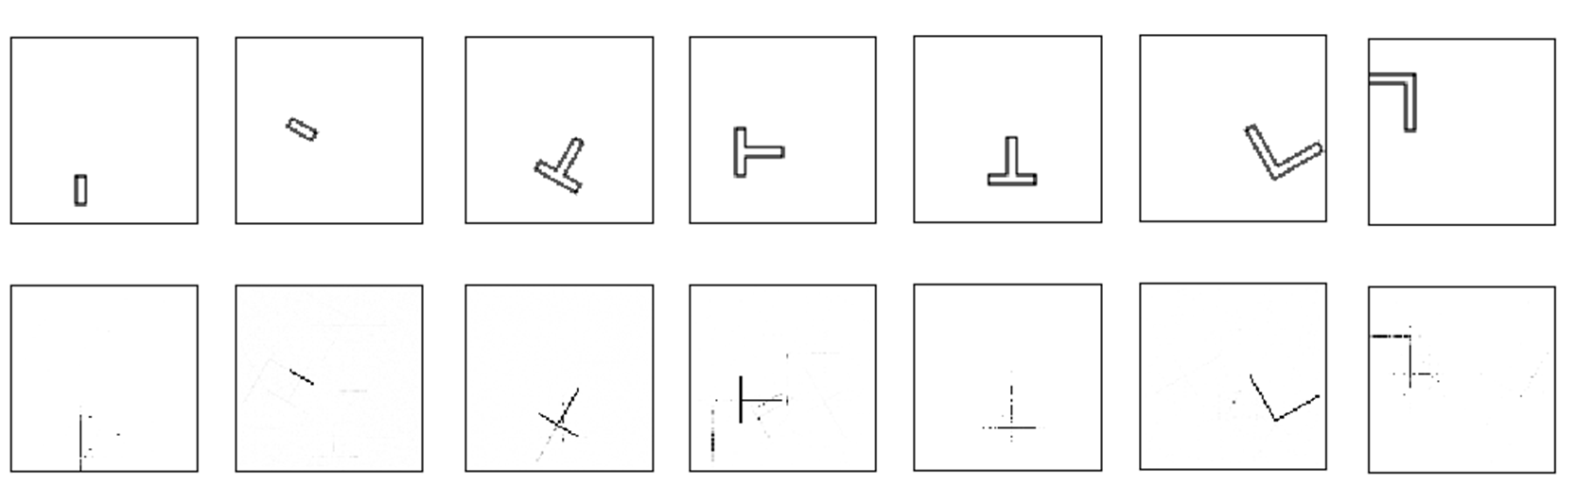
Results
Not very perfect but encouraging
NN is correct with
  The location (bounding box)
  Dimension Reduction is seen
But, still some stray points and misses

Slide 41
What Next?
More Network Architectures
Sequence-to-Sequence based approaches, taking closed thin polygon as input and polyline as output
Extending to 3D, ie Midsurface

Slide 42
END NOTES

Slide 43
Summary
Various applications need lower dimensional representation of shapes.
Midcurve is one- dimensional(1D) representation of a two-dimensional (2D) planar shape.
Used in animation, shape matching, retrieval, finite element analysis, etc.

Slide 44
Summary
Approaches: Thinning, Medial Axis Transform (MAT), Chordal Axis Transform (CAT), Straight Skeletons, etc., all of which are rule-based.
Proposing a novel method called MidcurveNN which uses Encoder-Decoder neural network for computing midcurve from images of 2D thin polygons in supervised learning manner.

Slide 45
Summary
This dimension reduction transformation from input 2D thin polygon image to output 1D midcurve image is learnt by the neural network,
Which can then be used to compute midcurve of an unseen 2D thin polygonal shape.

Slide 46
Thank you
yogeshkulkarni@yahoo.com

